Slide 1
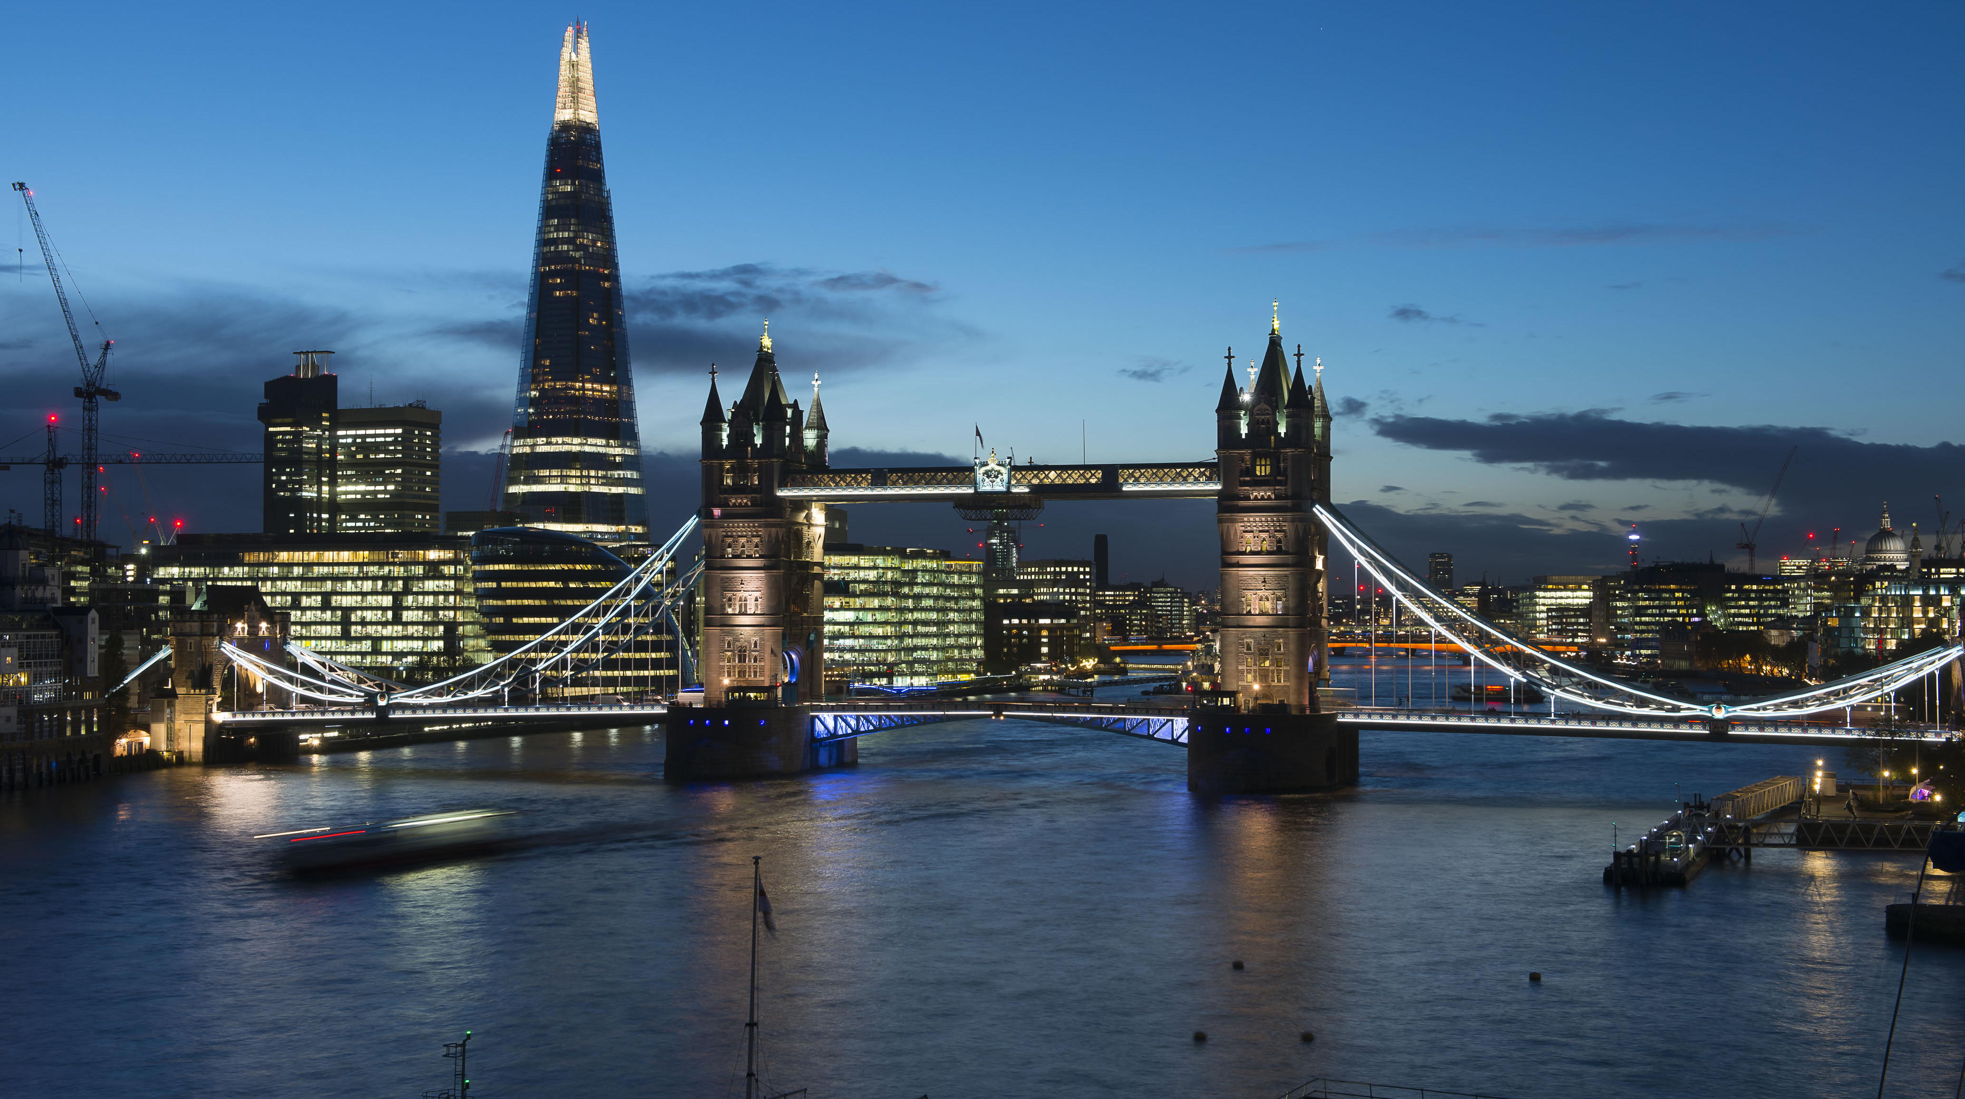

Image Synthesis with a Convolutional Capsule Generative Adversarial Network
Cher Bass et al. (2019). MIDL

Slide 2
Overview
Problem
Lack of large curated biomedical image datasets with labels hampers applicability of Deep Learning.
Hypothesis
Can data synthesis be used as an augmentation tool? Given a specific task (i.e. segmentation), could models trained on synthetic data generalise well to unseen real data?
Aims
To develop a reliable generative model that can produce realistic synthetic images from few real examples.
To test the performance of a downstream task when training on synthetic data only or synthetic data + few real examples, in comparison with training on real data only.

Slide 3
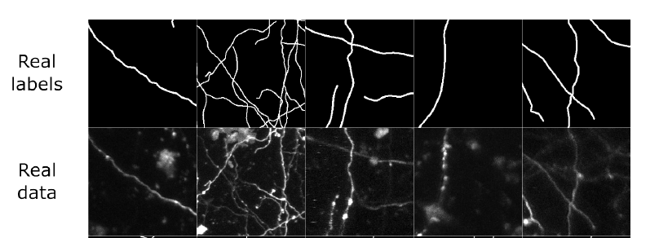
Overview
Proposed Solution
Conditional Generative Adversarial Network (cGAN) with the introduction of convolutional capsule architecture in the generator to group similar features.
Generate synthetic images conditioned on a segmentation image.
Train a U-Net on synthetic images to perform segmentation and test on real images
Application
Segmentation of two-photon microscope images of mice cortical axons

Slide 4
Basic Concepts
Capsule Networks and Dynamic Routing

Slide 5
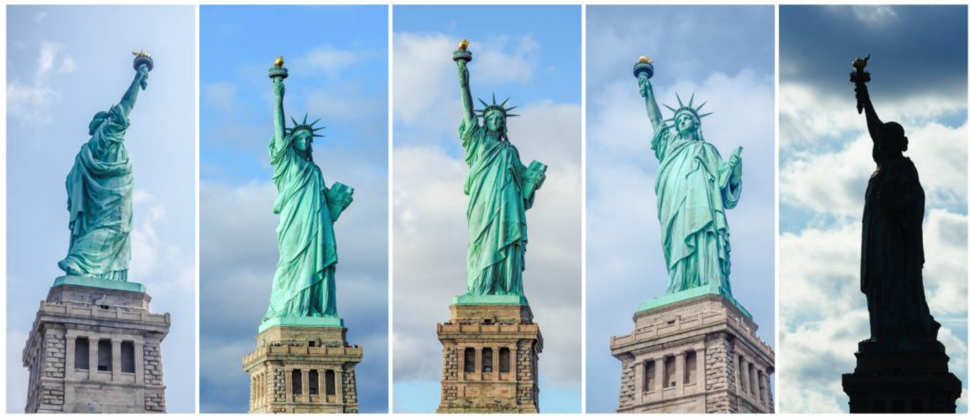
Objects representation in space
Representation of objects in the brain does not depend on view angle.
Relationships between 3D objects can be represented by a so-called pose (i.e. translation + rotation)
In order to correctly do classification and object recognition, it is important to preserve hierarchical pose relationships between object parts.

Slide 6
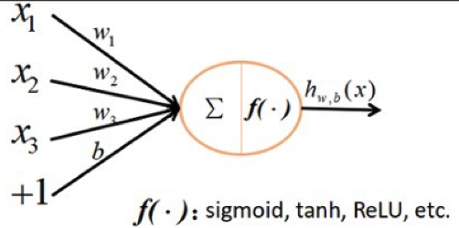
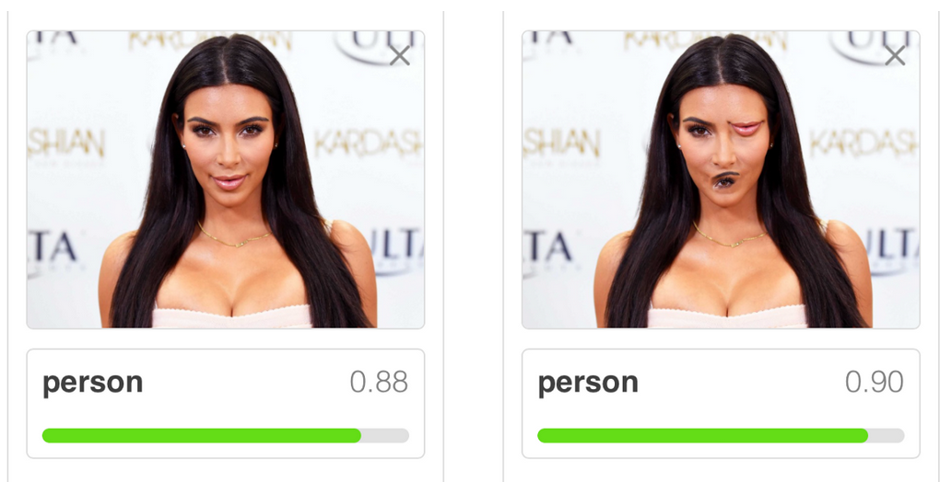
Limitations of CNN
In neural networks, each neuron combines lower-level features into higher-level ones through a weighted sum (+ nonlinearity)
Pose relationship between features is not accounted for
Max pooling and successive convolutional layers are used to reduce the input size → varying receptive field to detect features across larger regions, but still loses spatial information
Both images are classified as “person” by standard CNN
Better classification can be achieved if we incorporate the spatial relationship between eyes, nose, mouth within the face.
https://hackernoon.com/capsule-networks-are-shaking-up-ai-heres-how-to-use-them-c233a0971952
Notes:
Somehow, CNN would just rely on presence/absence of a feature, not on WHERE it is presenct.

Slide 7
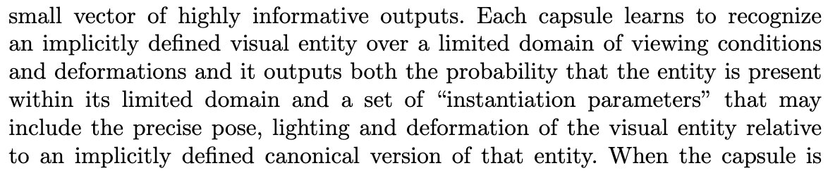
What is a capsule?
Capsule theory incorporates relative relationships between objects through 4D pose matrix
From Hinton et al. (2011),
Transforming auto-encoders:
Output vector
Capsule
Vector magnitude → probability of a feature to be detected
Vector direction → pose (state of the detected feature)
Inputs
→ “Activities equivariance”: neuronal activities will change when an object “moves over the manifold of possible appearances” but the probabilities of detection remain constant.
Notes:
When detected feature moves around the image or its state somehow changes, the probability still stays the same (length of vector does not change), but its orientation changes

Slide 8
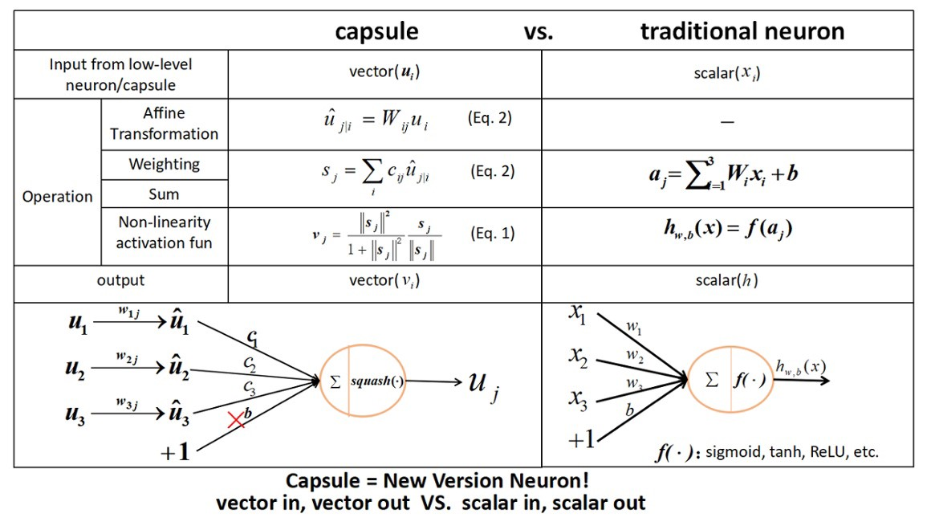
What is a capsule?
Notes:
When detected feature moves around the image or its state somehow changes, the probability still stays the same (length of vector does not change), but its orientation changes

Slide 9
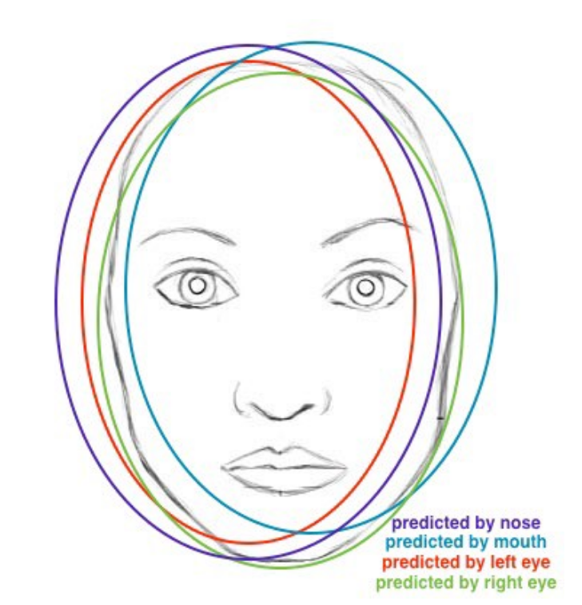
What is a capsule?
Affine transformation
The affine transformation W_{ij} encodes the spatial relationship between input feature i and output feature j
e.g. u₁ encodes left eye, u₂ nose, u₃ mouth and u_{j} face
W_{1j} represents where the face should be according to the position of the left eye.
If there is agreement between the predictions from the lower-level features, then it is highly probable that there is a face
Notes:
When detected feature moves around the image or its state somehow changes, the probability still stays the same (length of vector does not change), but its orientation changes

Slide 10
What is a capsule?
Weighting
Instead of being learnt through backpropagation, the weights for each inputs are computed through dynamic routing (wait for it…)
Sum
Nothing new here
Notes:
When detected feature moves around the image or its state somehow changes, the probability still stays the same (length of vector does not change), but its orientation changes

Slide 11
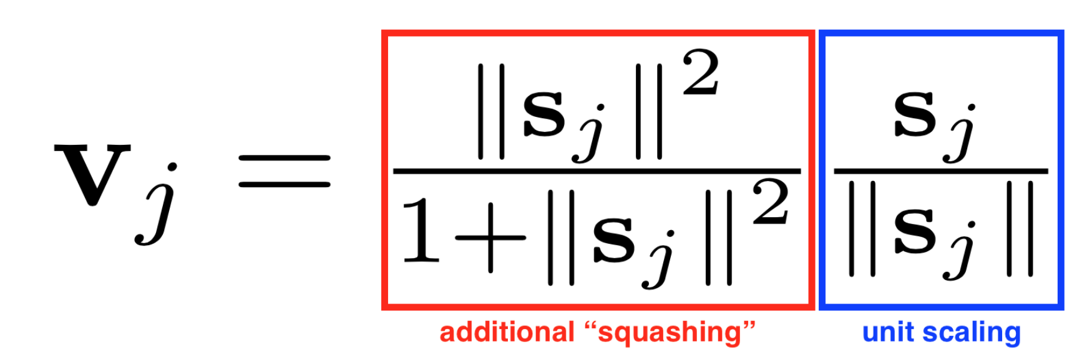
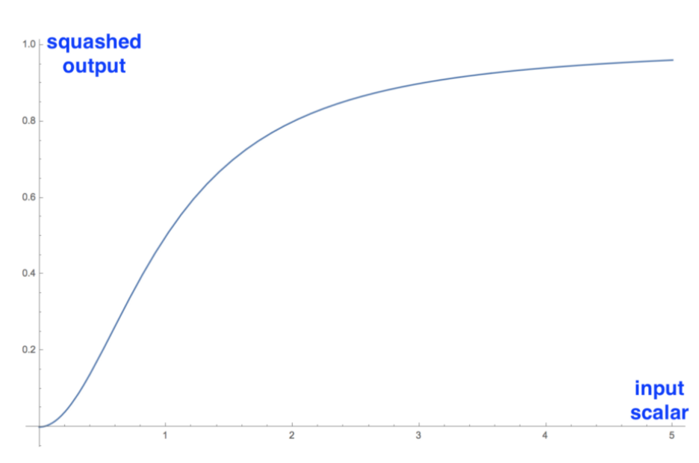
What is a capsule?
4. Vector-to-Vector non linearity
Achieved through the “squash” operation: each vector is squashed to have length < 1 but without changing direction
Notes:
When detected feature moves around the image or its state somehow changes, the probability still stays the same (length of vector does not change), but its orientation changes

Slide 12
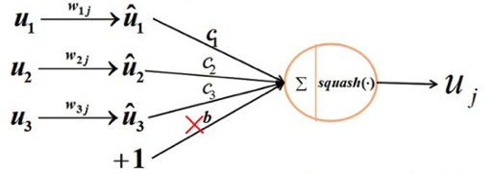
Dynamic Routing Algorithm (original version)
Basically describes the forward pass from “child” capsule i in to “parent” capsule j
Capsule j1
Capsule j2
How much of the output of capsule i should be transferred to capsule j1 and j2?
i.e. How can I define the weights c_{ij}?
Intuition:
The output of i seems to fall closer to the predictions from other lower level capsules (red clusters) in Capsule j2, so c_{ij2} should be higher than c_{ij1}
W_ij1
W_ij2
Output of Capsule i
Notes:
Softmax forces cij to be non-negative and sum to 1 → enforces some sort of probabilistic nature onto cij

Slide 13
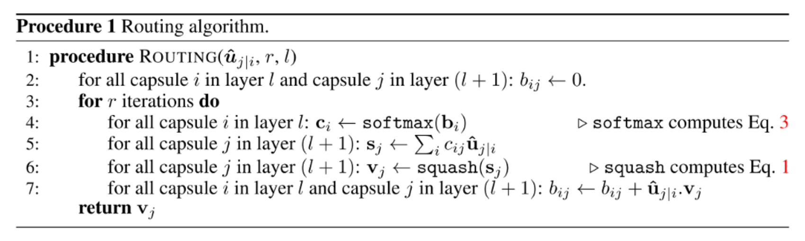
Dynamic Routing Algorithm (original version)
Basically describes the forward pass from “child” capsule i in to “parent” capsule j
C_ij → weight for output of capsule i towards capsule j
S_j → linear combination of all input vectors to capsule j
V_j → final output for capsule j after nonlinearity
Notes:
Softmax forces cij to be non-negative and sum to 1 → enforces some sort of probabilistic nature onto cij
At first iteration all cij will be equal to 0.5 → max confusion and uncertainty: each lower lever capsule does not know which higher level capsule will best fit their output.

Slide 14
Dynamic Routing Algorithm (original version)
Weight updates
The dot product looks at the similarity between the input (to capsule j from capsule i) and the final output of capsule j
Inputs from i that are closer to the output of j will be weighted more.
Process is iterated r times to refine the estimate.
Notes:
Softmax forces cij to be non-negative and sum to 1 → enforces some sort of probabilistic nature onto cij
At first iteration all cij will be equal to 0.5 → max confusion and uncertainty: each lower lever capsule does not know which higher level capsule will best fit their output.
In the original paper they suggest 3, as more iterations tend to overfit

Slide 15
References
Sabour, S., Froost, N., Hinton, G.E., (2017) “Dynamic Routing Between Capsules”, NIPS 2017 (https://arxiv.org/abs/1710.09829)
LaLonde, R., Bagci, U. (2018), “Capsules for Object Segmentation”, arxiv (https://arxiv.org/abs/1804.04241)
Recommended tutorial: https://medium.com/ai%C2%B3-theory-practice-business/understanding-hintons-capsule-networks-part-i-intuition-b4b559d1159b (and following parts)

Slide 16
Back to the paper…
Proposed method

Slide 17
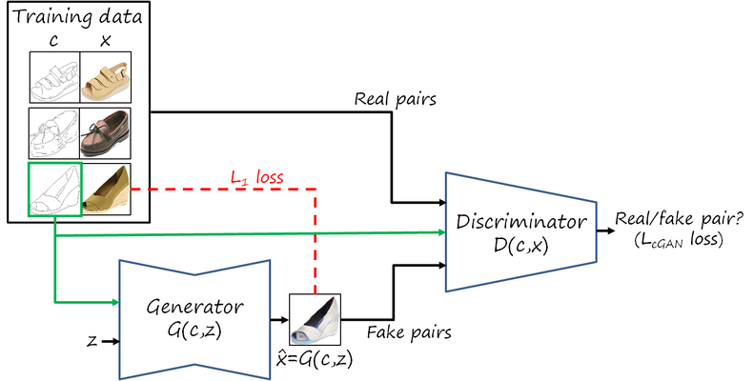
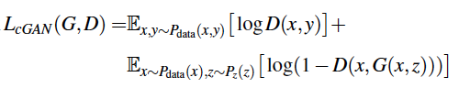
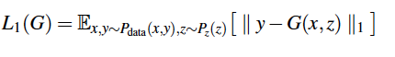
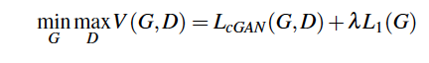
From Pix2Pix …
Generative Adversarial Network where stronger pixel-to-pixel correspondence is enforced by the loss function
1. Adversarial loss
2. Pixel-to-pixel correspondence
⤋

Slide 18
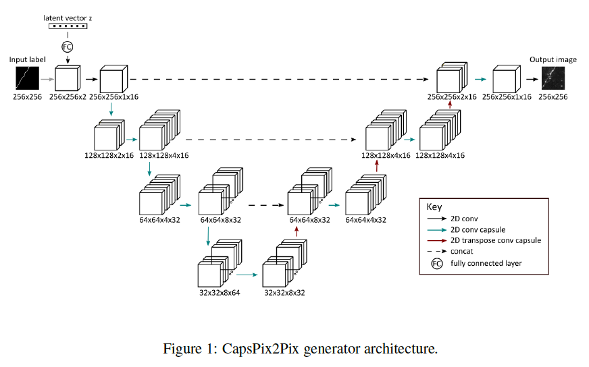
… to CapsPix2Pix
Generator
U-Net encoder-decoder network with skip connections and Convolutional Capsules
Input: segmentation concatenated with a latent vector¹ to generate a distribution of images
Discriminator
Standard DCGAN (2D convolutions + Batch norm + leakyReLU followed by final fully connected layer).
Input: image and segmentation
¹As opposed to dropout, which is instead used in Pix2Pix

Slide 19
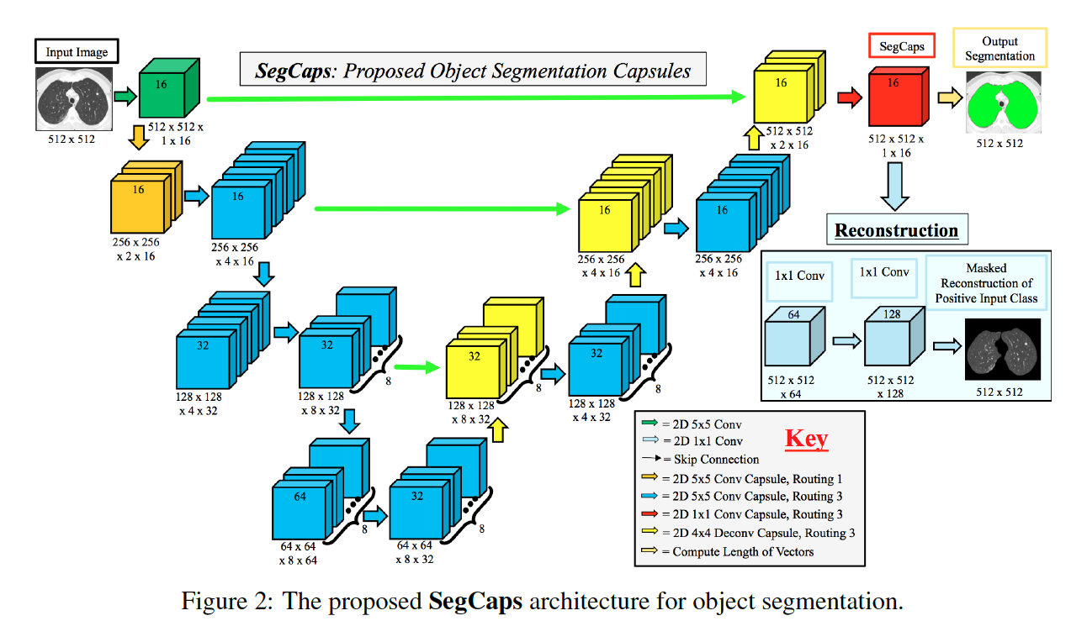
Convolutional Capsules
Traditional capsules
use high-dimensional transformation matrices W_{ij}
are extremely computationally expensive → applied only to 32x32 images
need to define a priori the size of the matrices based on the input
Convolutional Capsules (LaLonde et al, 2018):
children are routed to parents within a defined spatially-local kernel
transformation matrices are shared within a capsule type but not across capsule types
convolutional-deconvolutional architecture to compensate for the loss of global connectivity

Slide 20
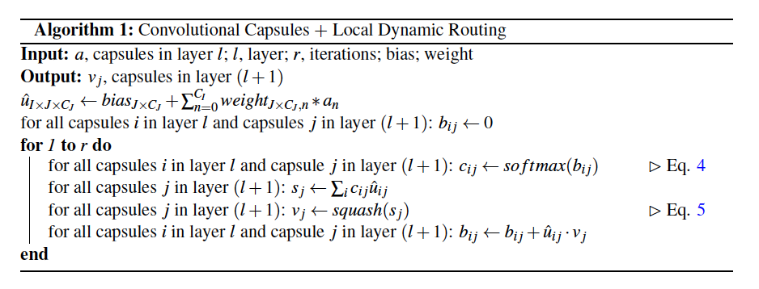
Locally-Connected Dynamic Routing Algorithm
Dynamic Routing Algorithm
for Convolutional Capsules
Original
Dynamic Routing Algorithm

Slide 21
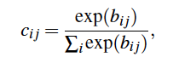
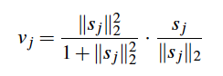
Locally-Connected Dynamic Routing Algorithm
Softmax (Eq 4)
Squash operation (Eq 5)
Instead of matrix transformation, a convolution layer is applied to map the activations from the children capsules to the parent “predictions”.
The convolution kernels are shared between the input capsules → less parameters!

Slide 22
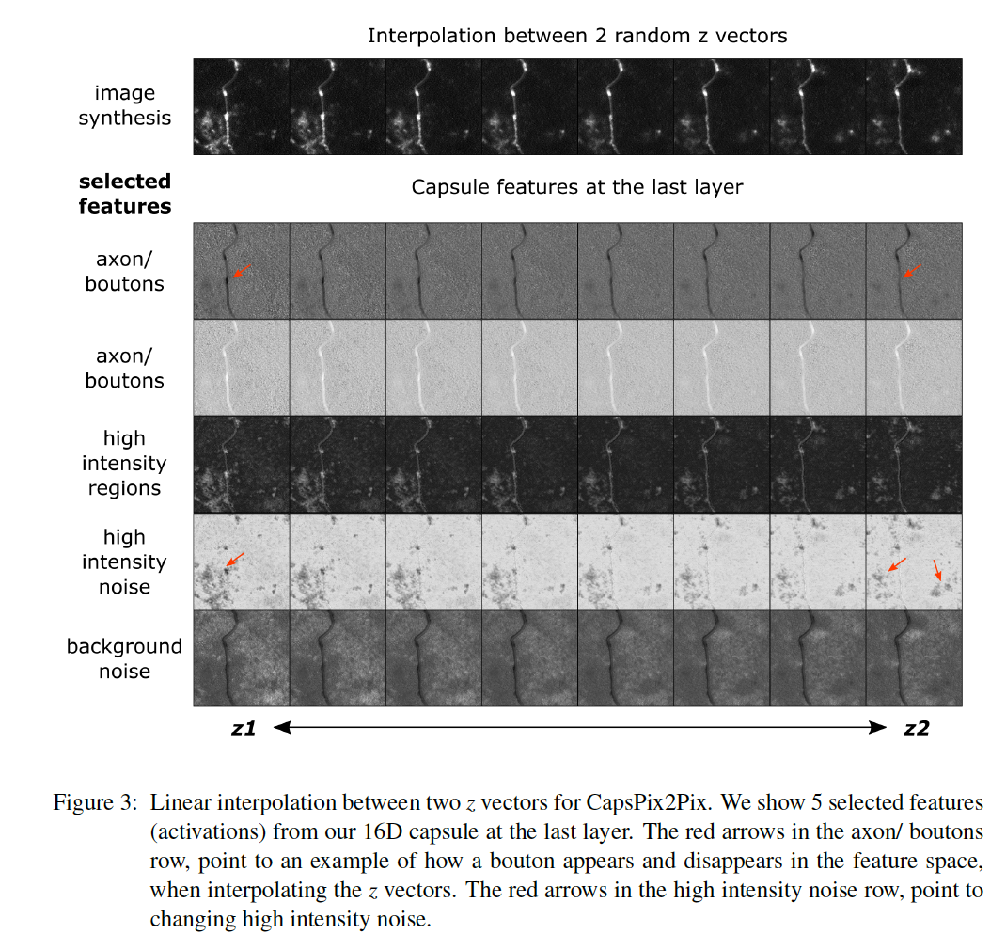
The role of the latent space

Slide 23
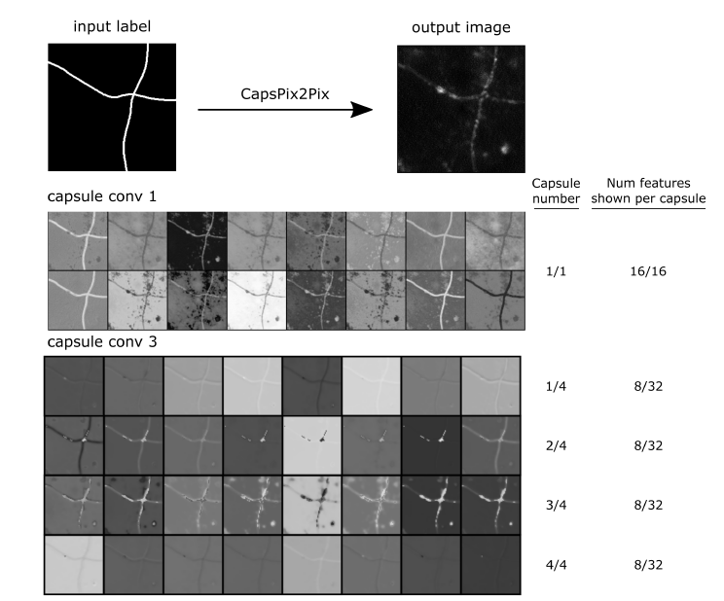
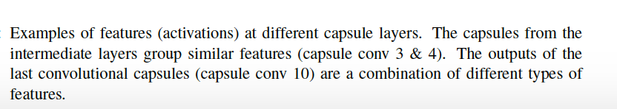
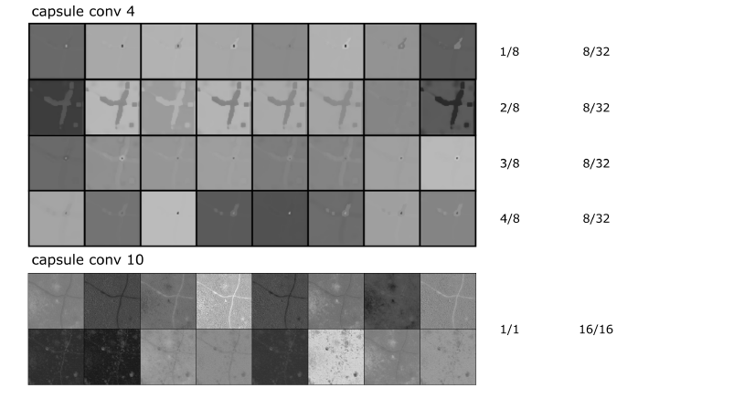
Clustering features in the capsules 1/2

Slide 24
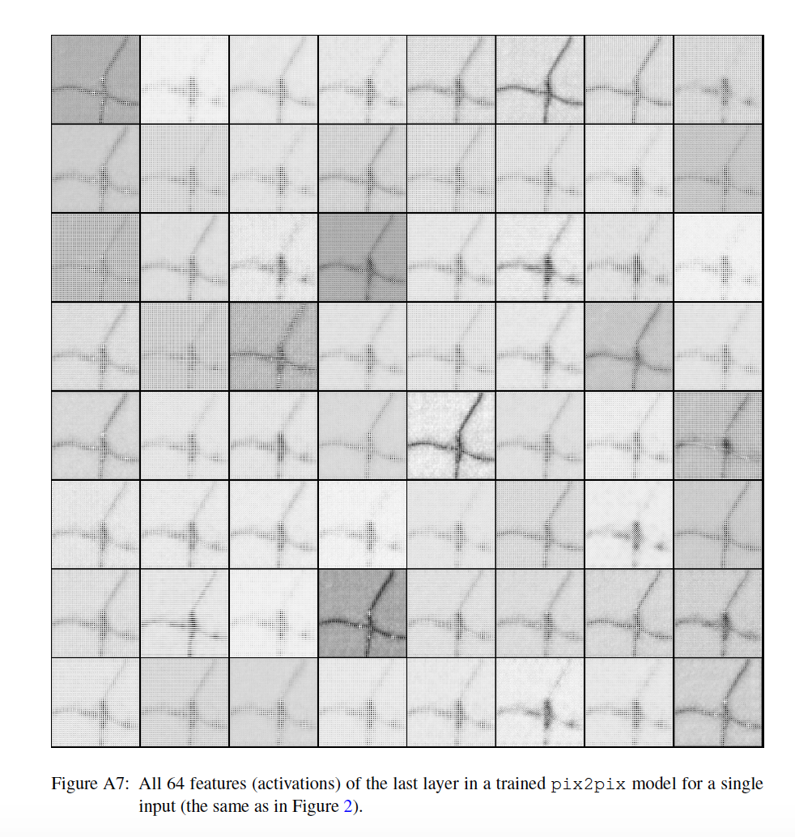
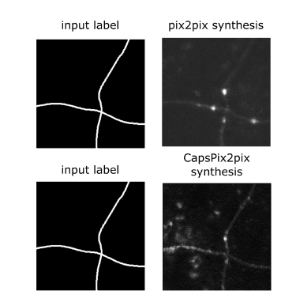
Clustering features in the capsules 2/2
Pix2Pix – Last layer activations
CapsPix2Pix – Last layer activations
Synthetic images comparison

Slide 25
Discussion

Slide 26
To sum up…
Pros
In computer vision, capsules have shown to successfully learn using only a fraction of the data
CapsPix2Pix 7x less parameters than Pix2Pix
More variation in the generated data
Successful data augmentation for a segmentation task
Features clustering and visualisation
Cons
Computationally expensive (5x slower at training, 13x slower at testing)

Slide 27
Discussion points
Would this be as effective on a multi-class problem? Could it work on more complex anatomy, e.g. for MRI or CT synthesis?
How much of the output variability is given by the capsules and how much is actually due to the latent space (as opposed to dropout used in Pix2Pix)? For what type of problems are capsules actually needed?
Are the convolutional capsules losing the benefits ”global” relationships introduced with standard capsules?
Notes:
A bit hard to disentangle what is the effect of the capsules and if they are actually needed.

